Slide 1
The Economics of Native Seed in Nevada
Nevada Native Seed Forum
Winnemucca, Nevada
28 March 2012
Richard D. Bartholet
University Center for Economic Development
University of Nevada, Reno
Michael H. Taylor
Dept. of Economics &
Cooperative Extension
University of Nevada, Reno
Photo Courtesy of Jon Bates
Notes:
Two separate goals
Increase the supply of genetically-appropriate native seed and plant material for restoration and post-fire emergency rehabilitation projects in Nevada
But: The seed could be cultivated in outside the state.
To increase supply of seed and plant material produced in Nevada, with a focus on cultivation over wildland collection. Income diversification for agricultural producers in Nevada. Help achieve rural development goals.
But: The seed and plant materials could be grown in Nevada and used in (i) non-wildland restoration applications (e.g., ski resorts, golf courses, etc.) and (ii) could be sold out of state
Fundamental Question
How are these two goals related?
Why is it important to have a network of native seed producers in Nevada to better meet ecological restoration goals?
The answers to this question are in this room

Slide 2
Economics of Native Seeds: Second Best?
Restoration Outcome
Pay-for-performance?
The Second Best
How to orient the industry to meet these restoration objectives
Solution: Input Constraints
Seed menus, seeding recommendations
Consistent with contract theory when pay-for-performance is infeasible
Notes:
Restoration Outcomes
If you could simply pay private contractors for restoration outcomes then the economic problem would be solved: private incentives are aligned with public incentives
There are, of course, numerous reasons why this is infeasible: difficulty in defining success, monitoring success, variability due to weather, cash flow – who can wait 10 years to get paid!
Also, the problem of defining the restoration outcome: sage grouse habitat? Forage? Soil stabilization?
Economic Problem: Second Best
How to orient the industry to meet the restoration objectives given the private objectives and constraints of all the participants
Solution: Seed Menus
Constraining inputs and potentially application methods to increase the chances of restoration success
This is consistent with contract theory in economics in cases where pay-for-performance measures are infeasible.

Slide 3
Success Rate
Success Rate/Acres Treated
Trade-off?
Acres

Slide 4
Success Rate
Higher Budget?
Acres

Slide 5
Success Rate
More Efficient Private Native Seed Market…
Acres

Slide 6
Success Rate
Research: Right seed, Right Place, Right…
Acres

Slide 7
Policy Discussion
Consolidated Seed Buys
Monopsony?
Standing orders for desired species
Market Risk
Forward Contracts (IDIQs, etc.)
Production Risk
Cost-plus contracts; USDA programs
Wildland Collection
Streamlined NEPA; Flexible contracts
Industry Consolidation
Problem for restoration? Opportunity for producers?
Notes:
Seed Menus
Economic considerations: cost and availability

Slide 8
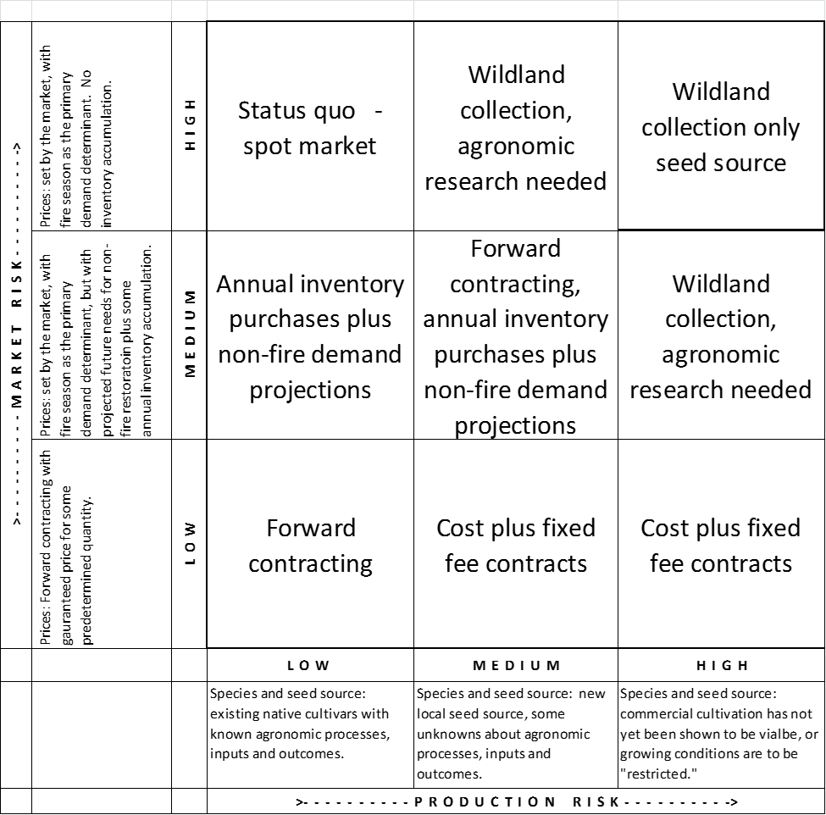

Slide 9
Extra Questions
Questions to ask a) buyers/users and b) growers:
In regard to native seeds for which there are existing growers in other states, what, if any, additional incentives do you think would be needed to encourage Nevada growers?
In regard to native seeds for any plants for which there are not currently any commercial growers of the desired seed because “locally sourced seed” is a new requirement, what, if any, additional incentives do you think would be needed to encourage Nevada growers?
In regard to native seed for any plant where commercial production has not yet occurred because they are “hard to grow”, what additional incentives do you think would be needed to encourge agronomic production?

Slide 10
Thank You!

Slide 11
Acknowledgements
U.S. Fish and Wildlife Service
Sagebrush Ecosystem Restoration Research Team (SERRT) project
University of Nevada Cooperative Extension
University of Nevada, Reno, College of Agriculture, Biotechnology, and Natural Resources
University of Nevada, Reno, College of Business
Nevada Department of Agriculture

